Slide 1
Project Presentation of Back End Engineering Project (BEE) (22CS026)
On
TRAVEL SPHERE
TEAM MEMBER | ROLL NO.
Sanisth Tara | 2210992247
Supervised By –
Rahul Sir
Department of Computer Science and Engineering, Chitkara University, Punjab

Slide 2
Introduction
TravelSphere is a travel technology company that empowers travelers to explore the world with confidence and ease. Its innovative solutions include a comprehensive trip planning platform, real-time booking capabilities, and a suite of travel management tools for corporate travel. By providing a user-centric, data-driven, and highly personalized travel experience, TravelSphere aims to revolutionize the travel industry.
2

Slide 3
Problem Statement
The traditional travel planning and booking process is often time-consuming, fragmented, and impersonal, leading to frustration and uncertainty for travelers. With an overwhelming amount of options and information available, travelers struggle to find the best deals, plan their trips efficiently, and manage their travel itineraries. Moreover, corporate travel managers face challenges in ensuring policy compliance, tracking expenses, and analyzing travel data. TravelSphere addresses these pain points by providing a seamless, personalized, and data-driven travel experience that simplifies travel planning, booking, and management.
3

Slide 4
Objective
Empower travelers to explore the world with confidence and ease:-
This objective is centered around providing travelers with the tools, resources, and support they need to plan and embark on their trips with confidence.
Provide a comprehensive and integrated trip planning platform:-
This objective is centered around offering a one-stop-shop for travelers to plan, book, and manage their trips from start to finish.
Streamline travel management for corporate travel managers:-
This objective is centered around providing a comprehensive and intuitive platform that simplifies the corporate travel management process, saving time and effort for travel managers
4

Slide 5
Key Learnings
User-Centric - TravelSphere is designed to be a user-centric platform, focusing on providing a seamless and personalized travel experience.
Design Efficient - To design an efficient TravelSphere platform, consider a modular architecture, streamlined user interface, automation, real-time data processing, scalability, and robust security measures.
Scalability - Add servers/instances (horizontal scaling) or increase server power (vertical scaling) to handle growing traffic and demand.
Data Security - To ensure data security in TravelSphere, implement encryption, access control, data backup and recovery, and compliance with regulations to protect sensitive data and systems.
5

Slide 6
Technical Details
Backend Development: Node js, Express.js, MongoDB , Bcrypt
Frontend Development: React.js, Tailwind CSS
Security : JWT Authentication, HTTPS, Cookies
Management : MongoDB, Mongoose

Slide 7
Advantages
Personalized Travel Planning.
Streamlined Booking Process
Real-time Travel Updates
Enhanced Travel Experience.
Increased Efficiency
Enhanced Security.
.

Slide 8
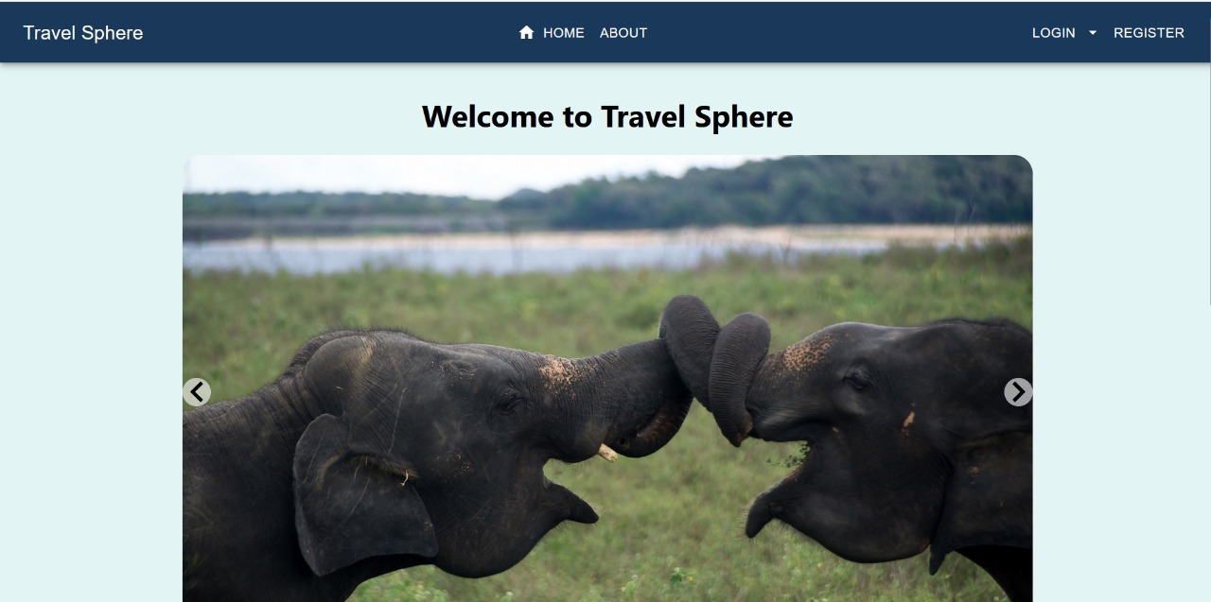
Project Highlight

Slide 9
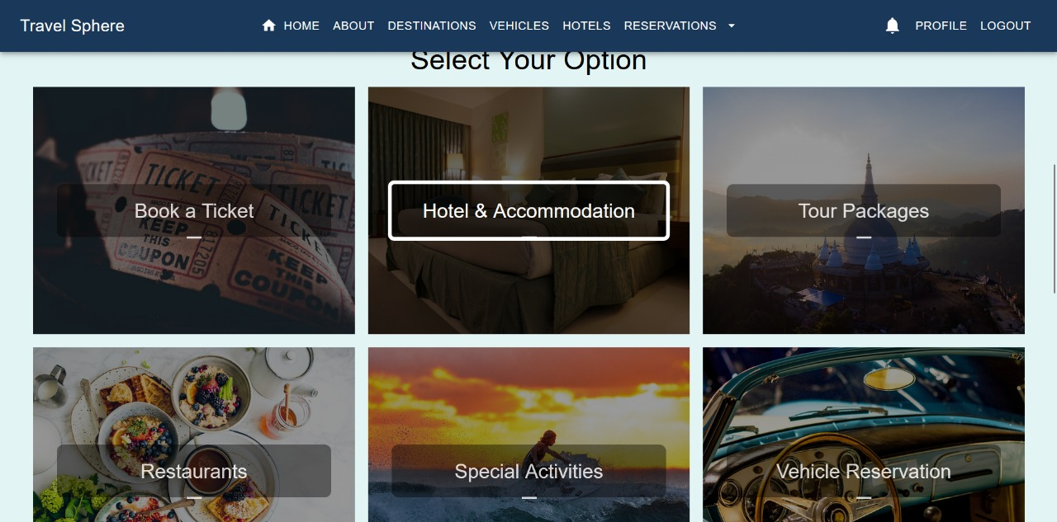
Project Highlight

Slide 10
Future Scope
Artificial Intelligence-powered Travel Assistants: Integrating AI-driven chatbots to provide personalized travel recommendations, real-time support, and automated booking processes.
Virtual and Augmented Reality Integration: Incorporating VR and AR technologies to enable users to explore destinations, hotels, and activities in a immersive and interactive way.
Predictive Analytics : Leveraging predictive analytics and machine learning algorithms to anticipate user behavior, optimize travel recommendations, and improve the overall user experience.
Partnerships and Collaborations: Forming strategic partnerships with travel industry players, such as airlines, hotels, and travel agencies, to expand the platform's offerings and improve the user experience.

Slide 11
CONCLUSION
In conclusion, TravelSphere is a revolutionary travel planning platform that offers a wide range of benefits and advantages to its users. With its personalized travel planning, streamlined booking process, real-time travel updates, and enhanced travel experience, TravelSphere is poised to transform the way people travel. As the platform continues to evolve and grow, its future scope is vast, with potential integrations of AI-powered travel assistants, virtual and augmented reality, blockchain-based secure payments, and more. With its focus on user experience, sustainability, and innovation, TravelSphere is set to become a leader in the travel industry, making travel easier, more enjoyable, and more rewarding for users around the world.

Slide 12
Thank You
13

